Slide 1
NBA player valuation project
Zhixin Li
Notes:
Hello everyone.
The aim of my project is to value NBA players. By constructing a fairly accurate model, I can identify undervalued and overvalued players and make suggestions to managers.

Slide 2
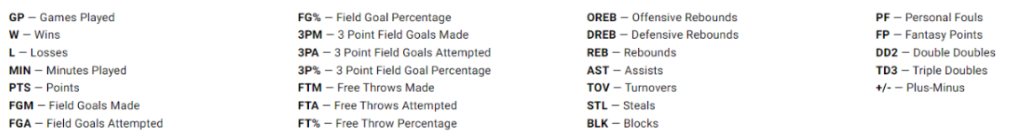
Data description
Time frame: 2005 – 2024 season
Size: 8332 rows * 55 columns
Attributes:
PLAYOFF: Years of PLAYOFF experience .
semi_final: Years reaching semi-finals in tournaments or leagues .
conf_final: Years participating in conference finals .
final: Years reaching final games in tournaments or leagues .
champ: Years on a championship-winning team .
PPG: Average points scored per game.
FGAPG: Average field goal attempts per game.
3PAPG: Average three-point attempts per game.
REBPG: Average rebounds per game.
ASTPG: Average assists per game.
TOVPG: Average turnovers per game.
STLPG: Average steals per game.
BLKPG: Average blocks per game.
PPM: Average points scored per minute of play.
FGAPM: Average field goal attempts per minute of play.
3PAPM: Average three-point attempts per minute of play.
REBPM: Average rebounds per minute of play.
ASTPM: Average assists per minute of play.
TOVPM: Average turnovers per minute of play.
STLPM: Average steals per minute of play.
BLKPM: Average blocks per minute of play.
Notes:
The time frame of this project is from the 2005 season to the present season.
With 8332 entries and 55 attributes.
The attributes are listed below. Some are from the original data source while others are self constructed（停顿10S）

Slide 3
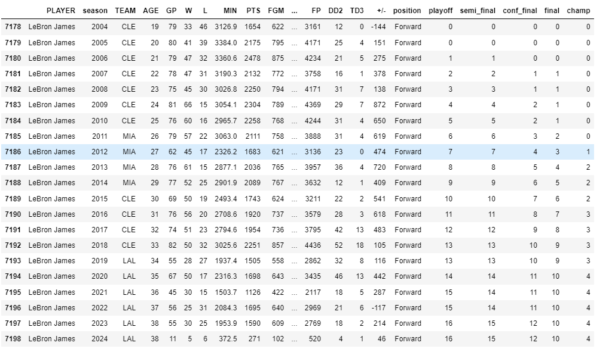
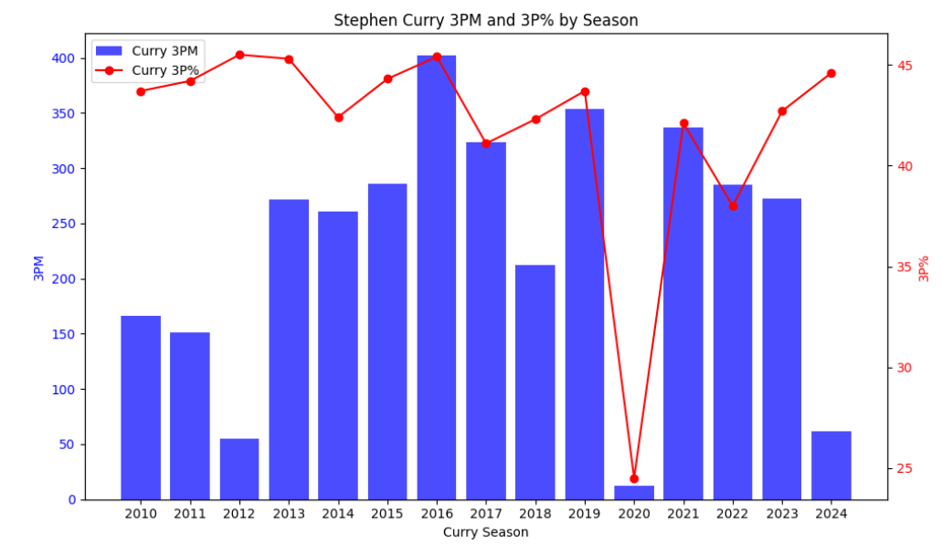
Explore data
Notes:
Here are some graphs generated when exploring the dataset.
This is the 3 point stats of the famous shooter Staphen Curry through out his career. He suffered severe foot injury in 2020. (点击）
This is a chart of the PLAYOFF history of Lebron James. So far he has 16 PLAYOFF appearances with 10 final appearances and 4 NBA titles.
These attributes were constructed by myself because I know teams value player’s PLAYOFF experiences and this could be factored into a player’s salary.

Slide 4
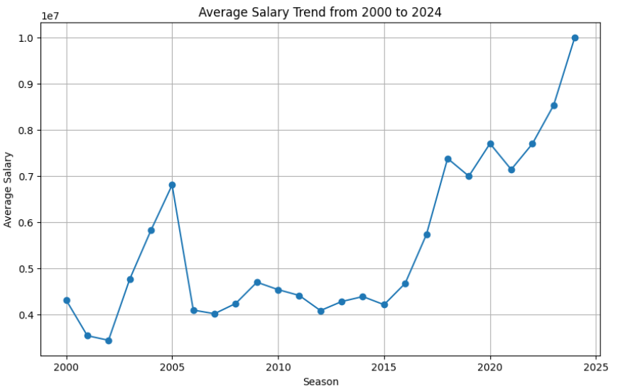
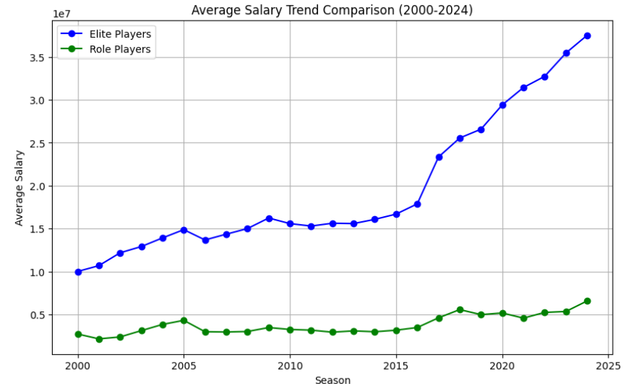
Explore data
Notes:
The left graphs showing the trend of average league salary, the right shows the star players salary ( the purple line) and role players salary(the green line). star players are defined as players who take up more than 20% of salary cap. It is interesting to observe that the role player’s salary did not change much while star salary rose with the average salary.

Slide 5
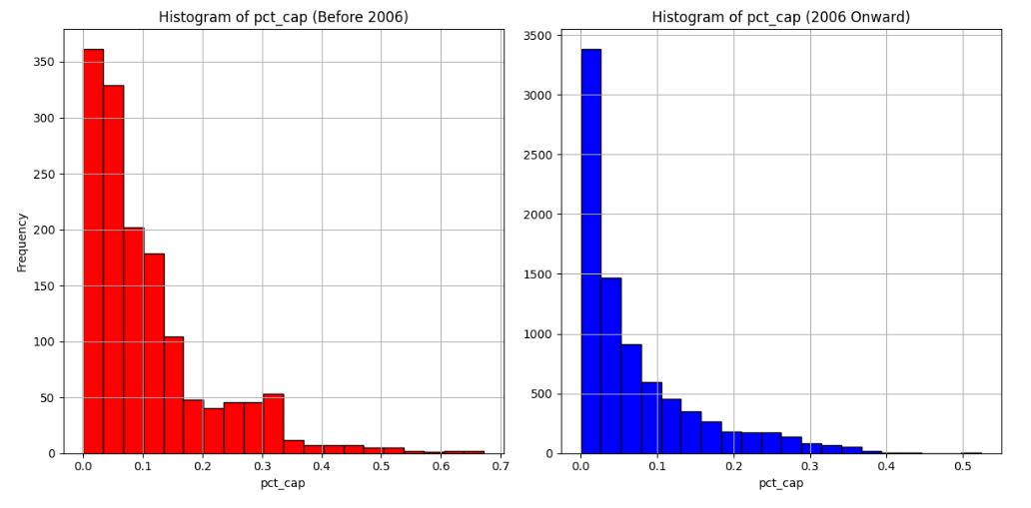
Explore data
Notes:
This shows the difference in salary distribution prior to 2005 and after 2005.
In 2005, a new labor contract took effect, which brought major changes to how NBA salary are determined.
This is the reason why this project only study the data from 2005 season till present.

Slide 6
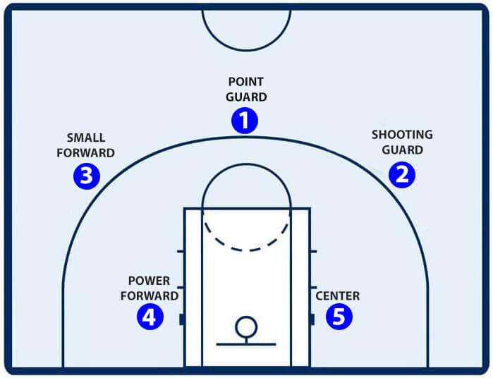
Notes:
This is a brief intro of the 5 positions of a basketball team.
The role of thumb is that the higher the number, the taller and stronger is the players and the closer he is to the basket.

Slide 7
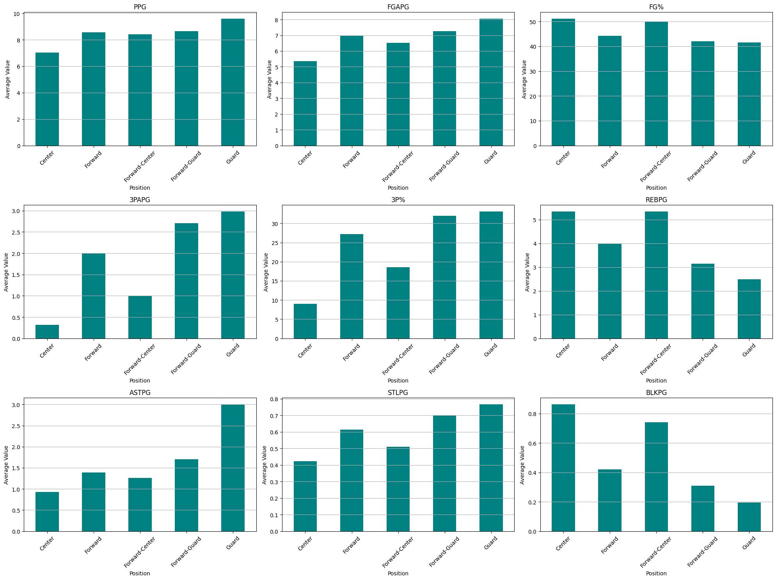
Notes:
Here is a graph comparing the average of attributes between different positions.
We can observe that guards have higher shooting percentage and assist, while center have higher rebounds and blocks.
Since different positions have different roles in the game, I have decided to value players based on their position.

Slide 8
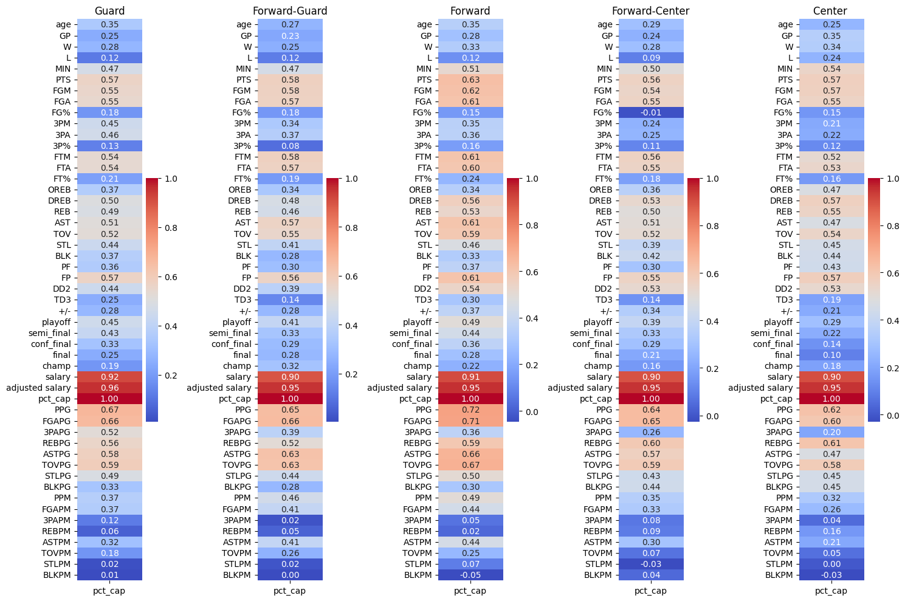
Notes:
This is the correlation between different attributes with the dependent variable for different positions.
This gives a guidance as to which attributes to choose and which to discard.
The higher the correlation, the more promising the attributes is.
Some promising ones are highlighted in yellow.

Slide 9
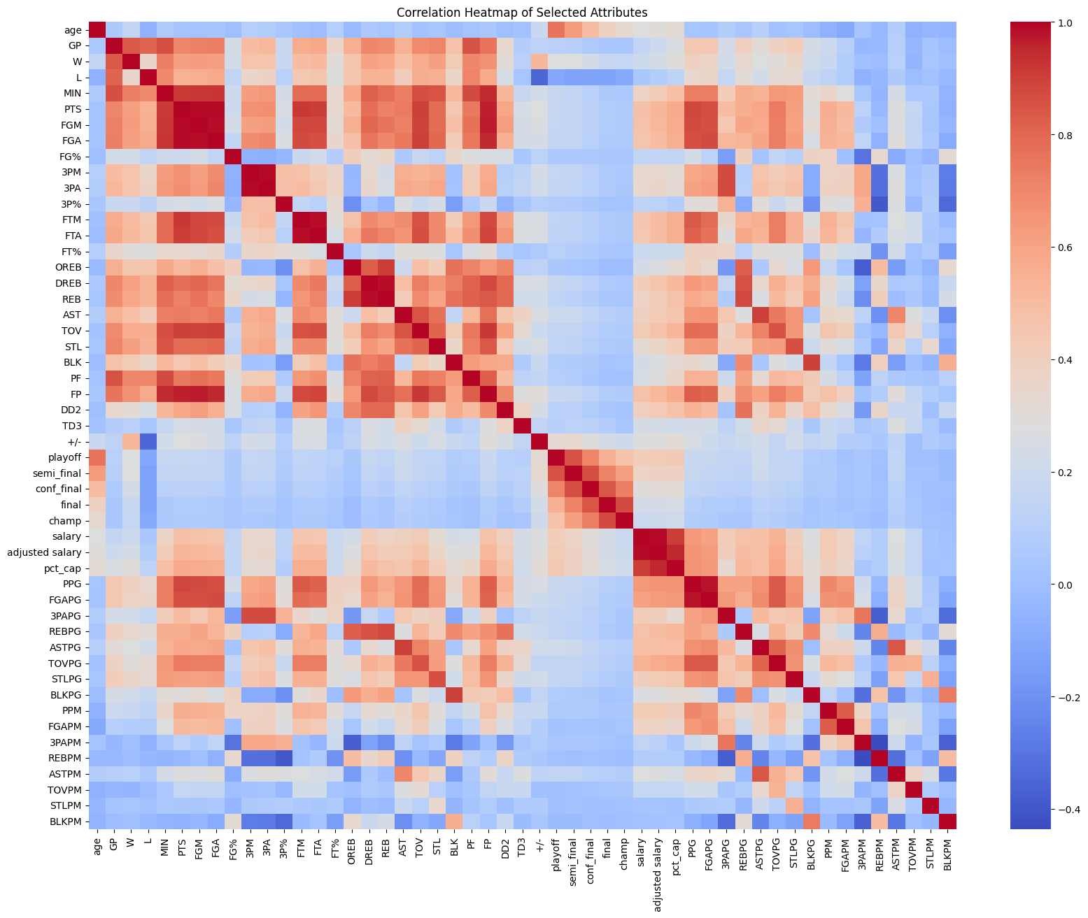
Notes:
This correlation map provide guidance to multicollinearity.
For example, although both “points per game” and “field goal attempt per game” are promising, we should only choose one because these two are highly correlated.

Slide 10
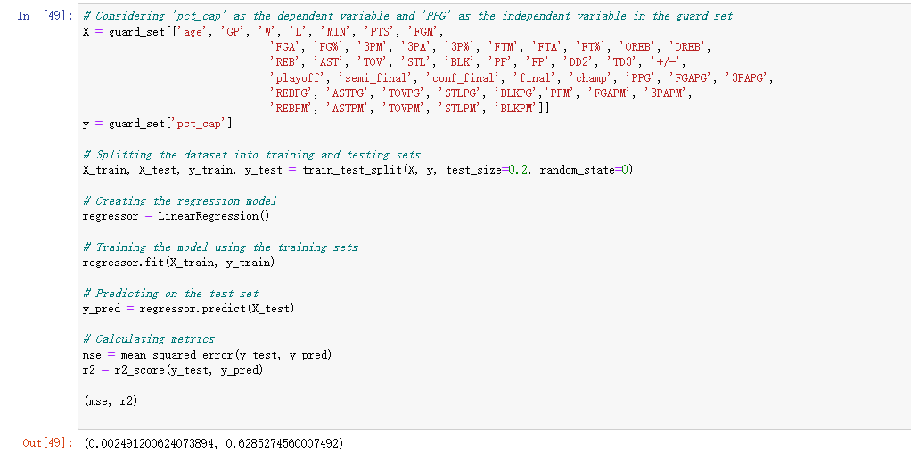
Regression
Notes:
Using the dataset of guards as an example.
By running a regression on ALL the attributes, we get a R2 of 0.63, which means that 63% of the difference in salary is explained with the attributes included.

Slide 11
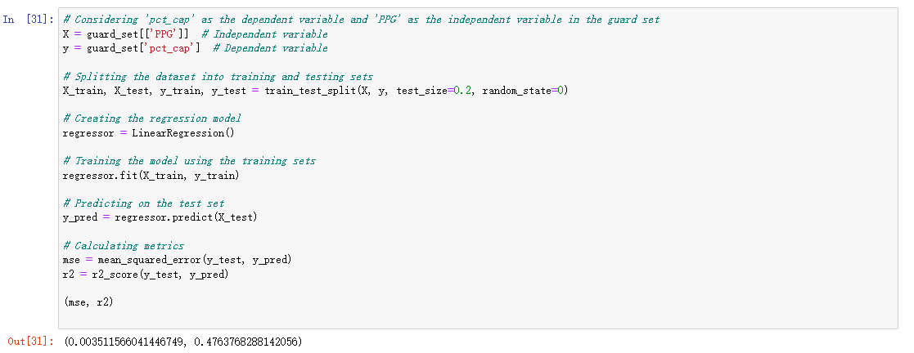
Regression
Notes:
“points per game” is the single most important stats in NBA, and not surprisingly, it alone could explain 48% of the difference in salary among players.
Moving forward, I plan to split the dataset between star players and role players. I also intend to try different regression models to try to improve the effectiveness of the models.
I would love to hear your suggestions! Thank you!

